Slide 1
Practical – 4 GIT & GITHUB
Aruna Kumbhar

Slide 2
https://classroom.google.com/c/ODcyMDU5MTU2OTYz?cjc=mls6kf2n

Slide 3
Git Branches
A Git branch is a separate workspace used to make changes without affecting the main project. Once the work is complete, the changes can be merged back into the main or master branch
Branches make it easy to:
Manage different tasks or features independently
Test changes without affecting live code
Collaborate with others efficiently

Slide 4
Types of Branches in Git
Git uses different types of branches to keep things organized and allow you to work on different tasks without disturbing the main project. Here are the most common types of branches you will work with:
Main (or Master) Branch: Stores the final, stable, and production-ready code.
Hotfix Branch: Used to quickly fix critical production issues and then merged back into main.
Release Branch: Prepares a new version for release, allowing final testing and minor fixes before merging.
Develop Branch: Combines all completed features for integration, testing, and ongoing development.
Feature Branch: Created to develop a specific feature and merged back into the develop or main branch once complete.

Slide 5
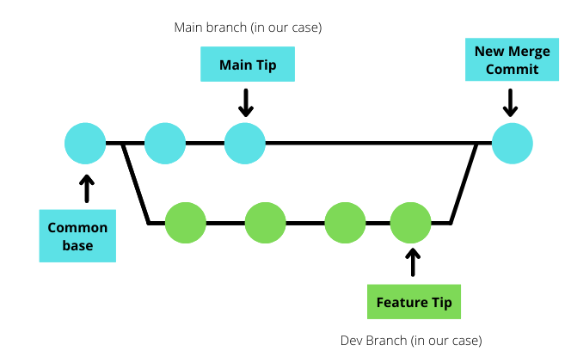
Git Merge
Git Merge combines changes from different branches into a single branch, integrating work while preserving history. It helps unify development without losing progress

Slide 6
Git Revert
You use git revert to record some new commits to reverse the effect of some earlier commits (possibly faulty ones). It is an “undo” command, but technically it is much more than that. Git revert does not delete any commit in this project history. Instead, it inverts the changes implemented in a commit and appends new commits with the opposite effect

Slide 7
Today’s Practical: What We Will Do
• Work in pairs: Student A + Student B
• Create a Git repository and push it to GitHub
• Create a feature branch and make a commit
• Raise and review a Pull Request
• Create a controlled merge conflict
• Resolve the conflict and complete the merge
• Create a new change and safely revert it

Slide 8
The Story: Two Developers, One Website
Student A
Student B
• Creates the initial repository
• Creates feature branches
• Raises the first Pull Request
• Creates the address side of the conflict
• Clones the repository
• Reviews and merges the PR
• Creates the phone-number side
• Helps resolve the conflict

Slide 9
Step 1 — Student A: Create GitHub Repository
Repository name: git-collaboration-lab Visibility: Public (for this classroom exercise) Do NOT add another README if using the local repository

Slide 10
Step 2 — Student A Clones the Repository
git clone “GITHUB Repository Link”

Slide 11
Step 3 – Student A: Create index.html
<header><h1>Git Lab</h1></header> <nav>Home | About | Contact</nav> <section id="hero">Welcome</section> <section id="about-us">About our college</section> <main><p>Collaborative development demo.</p></main> <footer id="contact">Contact us</footer>
• Save the file as index.html inside your project folder.
• Do not change the footer yet — we will use it later to create a conflict.

Slide 12
Step 4 — Student A Push changes
git status git add index.html git commit -m "Initial commit" git push

Slide 13
Step 5 — Student B Clones the Repository
git clone “GITHUB Repository Link” cd “Folder Name”

Slide 14
Step 6 — Student B Creates a Feature Branch
git checkout -b feature/about-us

Slide 15
Step 7 — Student B Make a Feature Change
<section id="about-us">Company/College information added</section>
• Save index.html.
• Run git diff to see exactly what changed.

Slide 16
Step 8 — Student B Commit the Feature
git diff git add index.html git commit -m "Add About Us information

Slide 17
Step 9 — Student B Push the Feature Branch
git push -u origin feature/about-us
• Open GitHub and verify the new branch exists.
• CHECKPOINT → Show the instructor the branch.

Slide 18
Step 10 — Student B Raise a Pull Request
• Open the GitHub repository
• Choose feature/about-us
• Click Compare & pull request
• Base = main
• Compare = feature/about-us
• Enter a clear title and short description
• Click Create pull request
Add Student A as reviewer

Slide 19
What Does the Pull Request Mean?
feature/about-us
PULL REQUEST
main
• Review the changed lines before merging.
• A PR is a discussion + review + merge point.

Slide 20
Step 11 — Student A Review and Merge the PR
• Student A opens the Pull Request
• Read the description
• Open Files changed
• Check whether the change is correct
• If satisfied, click Merge pull request
• Confirm the merge

Slide 21
Now We Create a Controlled Conflict ⚠️
• Both branches will edit the SAME footer line
• Student A → address
• Student B → phone number
• Git cannot automatically decide which one is correct
• We will resolve it by keeping BOTH values

Slide 22
Step 12 — Student A Creates Conflict Branch
git checkout main git pull origin main git checkout -b feature/footer-address

Slide 23
Step 13 — Student A Make a Feature Change
<footer id=“Contact”> 123 Git Lane</footer>

Slide 24
Step 14 — Student A Commits the Address
git add index.html git commit -m "Add physical address" git push -u origin feature/footer-address

Slide 25
Step 15 — Student B Creates the Other Side
git checkout -b feature/footer-phone

Slide 26
Step 16 — Student B Make a Feature Change
<footer id=“Contact”> 555-1099 </footer>

Slide 27
Step 17 — Student B Commits the Phone Number
git add index.html git commit -m "Add phone number" git push -u origin feature/footer-phone
• When Student B tries to push the changes, he gets conflict

Slide 28
Why Does the Conflict Happen?
Branch A
<footer id="contact">123 Git Lane</footer>
Branch B
<footer id="contact">555-0199</footer>
• Same file + same line + different content = merge conflict
• Git pauses instead of silently choosing one version.

Slide 29
Step 18 — Understand Conflict Markers
<<<<<<< HEAD <footer id="contact">555-0199</footer> ======= <footer id="contact">123 Git Lane</footer> >>>>>>> origin/main
• HEAD = your current branch version.
• Between ======= and >>>>>>> is the incoming/main version.
• These markers are NOT valid final code.

Slide 30
Step 20 — Choose the Final Version
<footer id="contact">123 Git Lane | 555-0199</footer>
• Delete ALL conflict markers.
• Save the file.
• Then stage and commit the resolution.

Slide 31
Step 21 — Complete Local Conflict Resolution
git add index.html git commit -m "Resolve footer conflict" git push origin feature/footer-phone

Slide 32
Step 22 — Revert a Previous Commit
• Create a small change on main
• Commit and push it
• Find the commit hash with git log --oneline
• Use git revert <commit-hash>
• Push the NEW revert commit
• Verify that the original commit remains in history

Slide 33
Revert Practical — Run It
git log --oneline git revert <commit-hash> git push origin main

Slide 34
Final Practical Flow — Say It Without Commands
1
Create repository
2
Branch
3
Commit
4
Push
5
Pull Request
6
Review / Merge
7
Create Conflict
8
Resolve
9
Revert
• main → feature → PR → merge → conflict → human decision → revert when needed

Slide 35
Quick Command Cheat Sheet
git status git branch git checkout -b feature/name git add . git commit -m "message" git push -u origin feature/name git pull origin main git fetch origin git merge origin/main git log --oneline git revert <commit-hash> git merge --abort

